Slide 1
Using Plant-Based Antimicrobials to Make Organic Leafy Greens Safer
Divya Jaroni, Ph.D
Assistant Professor
Food Microbiology
Oklahoma State University

Slide 2
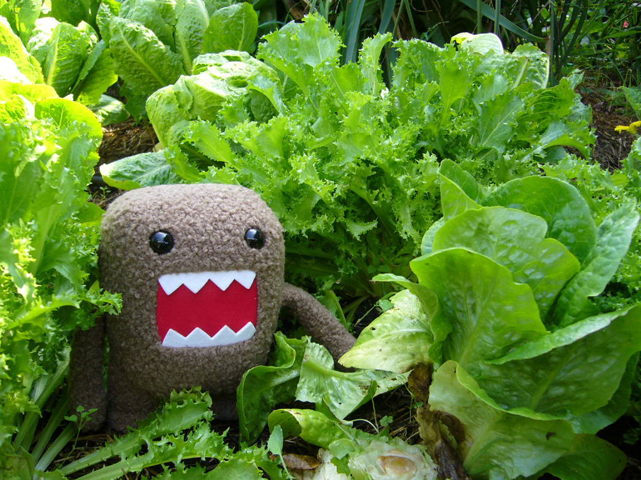
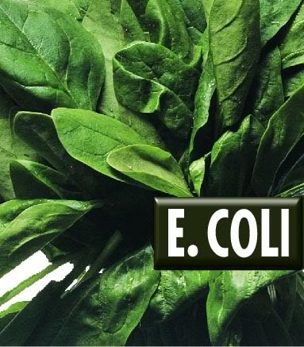
The Dangerous Bug!!

Slide 3
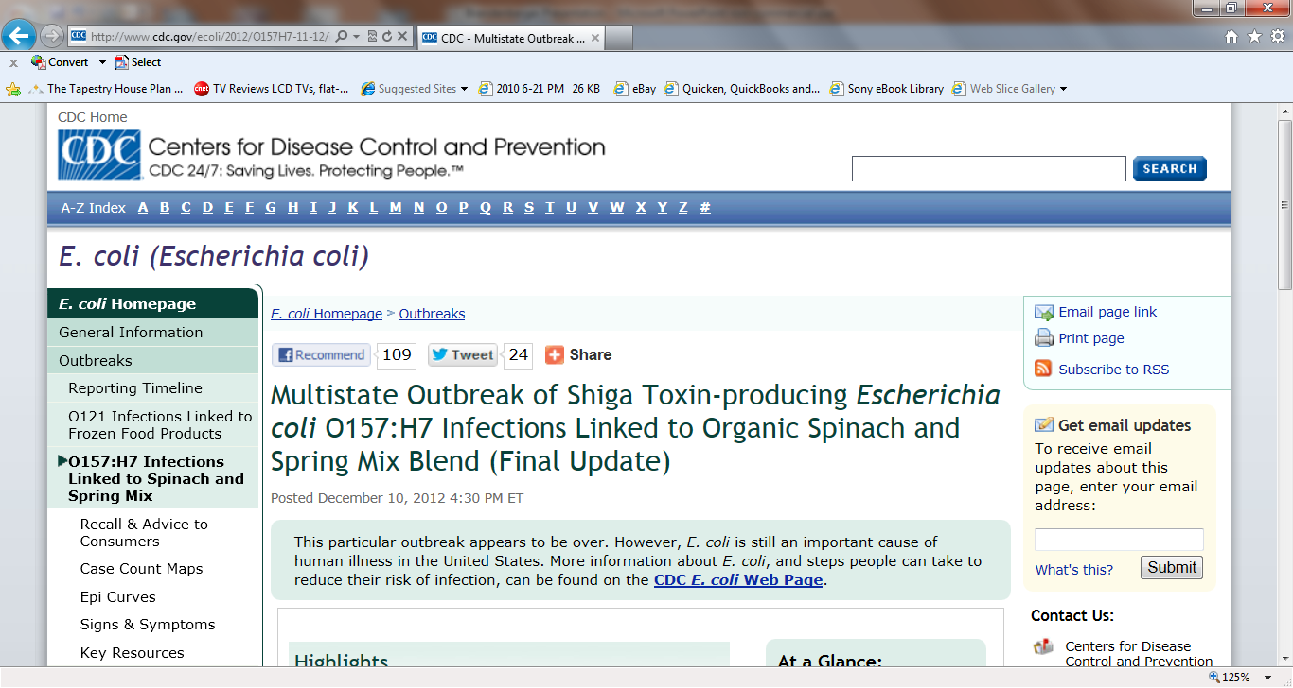

Slide 4
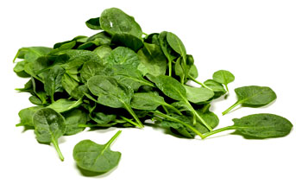
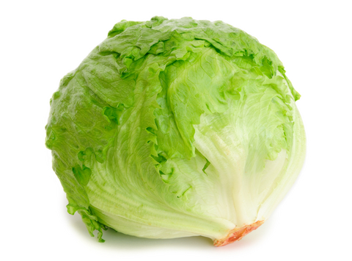
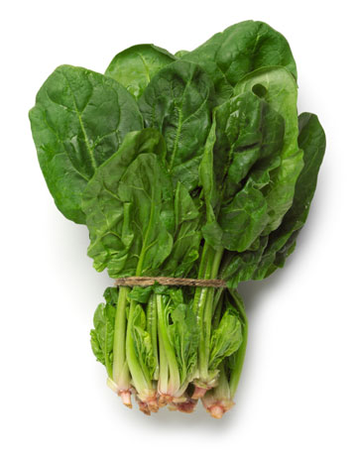
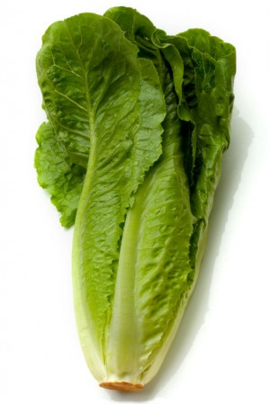
Leafy Greens Tested
Baby Spinach
Adult Spinach
Iceberg Lettuce
Romaine Lettuce

Slide 5
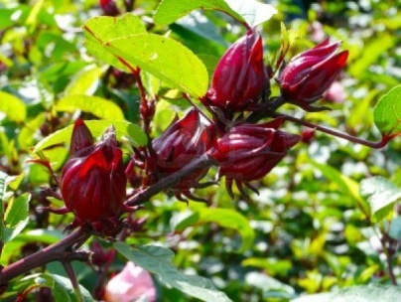
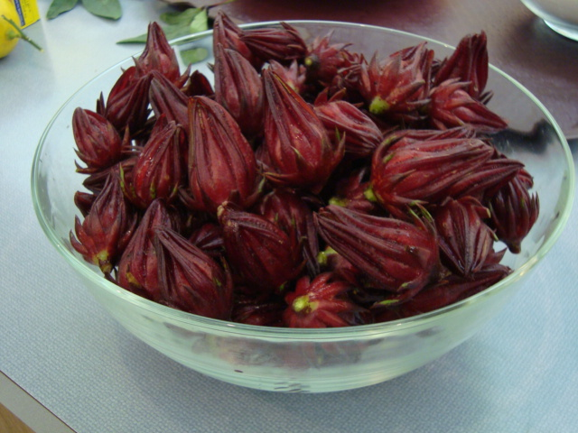
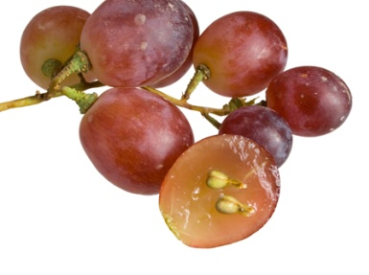
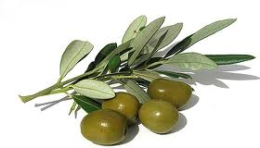
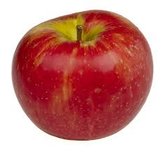
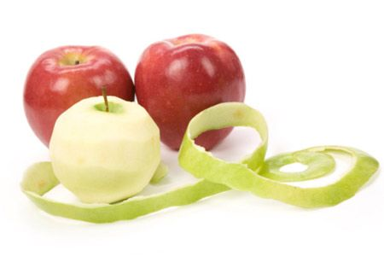
Antimicrobials Tested Plant Extracts
Grapeseed
Apple
Hibiscus
Olive

Slide 6
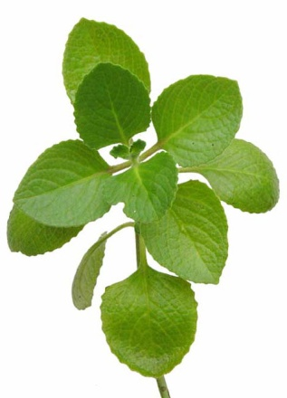
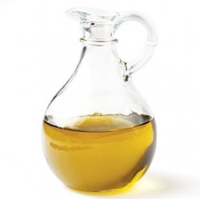
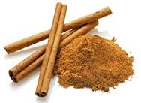
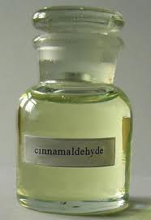
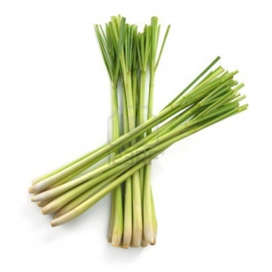
Antimicrobials Tested Essential Oils and Compounds
Oregano/Carvacrol
Lemongrass/Citral
Cinnamon/Cinnamaldehyde

Slide 7
Research
Leafy greens contaminated with E. coli
Washed with plant-based extracts, essential oils, or compounds
Bagged
Stored in the refrigerator for 3 days
Tested efficacy of plant antimicrobials immediately after washing, on day 1 and day 3 of storage

Slide 8
Findings
Immediate reduction (on Day 0) in bacterial populations
Extracts:
Most effective – Olive Extract
Essential Oils:
Most effective - Oregano oil
Plant Compounds:
Most effective – Carvacrol
NOTE: Carvacrol comes from Oregano!!!

